Slide 1
Parent PART Representatives’ Presentation to Allenby Parents Association
April 14th Meeting

Slide 2
Purpose of Tonight’s Meeting
Review new information since March 27th Meeting
Rank the options that will be presented on April 16th so PART Parent representatives can advise the TDSB and community at the April 16th meeting.

Slide 3
Recap of March 27th Meeting
167 individuals signed in. Some households may have signed in as one person.
Attendees were asked to ensure there was 1 ‘vote’ per household as to preferred options.
A presentation was given by the Space Committee on data analysis to date.
Options were presented at end of meeting.
Each household ‘voted’ for preferred options.

Slide 4
Results of the ‘Vote’
DECISION 1: What is the preferred option to obtain 4 Classrooms for FDK & Increased Enrolment?
Option 1: Build two classrooms and repurpose two rooms for classrooms: 117 votes
Option 2: Boundary Changes & repurpose space: 11 votes
Option 3: Boundary Changes as a stand alone option: 20 votes
Option 4: Repurpose space as a stand alone option: 5 votes
TOTAL VOTES: 153

Slide 5
Results of the ‘Vote’
DECISION 2: If repurposing space is part of the preferred solution, what space do you prefer be repurposed to find 2 Classrooms within Allenby?
Option 1: 1/2 music room & Room 006 (shared space with daycare) 48 votes
Option 2: Room 006 (shared space with daycare) & Room 1 or 2 (as shared space with daycare). 101 votes
TOTAL VOTES: 149
TOTAL NUMBER OF PARENTS SIGNED IN AT THE MEETING 169

Slide 6
Timeline and Summary of Upcoming Meetings
Public Meeting #2 – April 16th: Options will be reviewed and participants will be surveyed at the end of the evening as “consultation”.
PART meeting - April 30th: Final recommendations discussed by the PART. To be written up and discussed at the final Public Meeting May 15th.
Final Public Meeting #3 - May 15th: The PART committee will present its findings, in preparation for the report that will go to the Board of Trustees. There will be time for questions and comments from the audience.

Slide 7
What We Know
Allenby will remain a dual track school (French and English)
There is capital (building) funding available ONLY for FDK spending. The preferred building site is Allenby.
To reduce the number of children coming into Allenby going forward:
TDSB has closed optional attendance for French Immersion beginning 2013
TDSB may shrink the number of FI SK students from 60 to 56.
TDSB may shrink the FI catchment to “Allenby” only (with grandfathering).
TDSB is looking into the exemption possibilities for primary French Immersion classes

Slide 8
What We Know
TDSB has re-opened the discussion about using Bannockburn.
TDSB has advised the PART Committee that it supports the recently received Daycare Business model (continued exclusive use of Daycare Rooms 1 and 2)
TDSB has released 3 options for a build at Allenby.
TDSB staff is of the view that the build could be approved by the Ministry of Education.
The lunchroom is off the table as a room available for repurposing.

Slide 9
Options Going Forward
Build, Repurpose and limit FI students.
Re-open Bannockburn (Allenby North)
Boundary Changes

Slide 10
Options: Build: 2 classrooms on St. Clements
The least expensive and therefore only real option to build requires that the build be on the St. Clements side of the school.
All options to build require that the parking lot be expanded due to by-laws. A variance to this requirement can be sought.
This particular build may encroach on the existing track by a couple of feet.

Slide 11
Build Option Requires Re-purposing Space for 2 Rooms
To date, TDSB has estimated 4 rooms required to accommodate FDK and increased enrollment.
The build is for 2 FDK rooms. If 4 rooms in total are required, an additional 2 rooms must be found on the existing footprint.
006 is available for shared space (1 of 2 additional rooms)

Slide 12
Build and Re-purpose Option
Options for 2nd room are no longer clear.
TDSB Planning is currently investigating the possibility of NOT needing a 2nd room. Based on historic FI data, an enrolment bulge from 2004 that is no longer in the school, and a future change in the FI catchment, updated projections might show a 2nd room is not needed. We hope to know by TUESDAY’S meeting.
Music room is currently being re-evaluated because it may not be feasible to cut it in half.
Use of Rooms 1 and 2 currently used by daycare as “exclusive space” has been removed from the table by the TDSB.

Slide 13
Building On Site: Positive Considerations
The combination of (1) building 2 classrooms on site and (2) repurposing space and limiting FI students to find 2 additional classrooms could remove the need for boundary changes.
Building FDK classrooms could include building new bathrooms for those classrooms.

Slide 14
Building On Site: Negative Considerations
Increased strain will occur on ALL space (facilities/green space) and may impact on students feeling of well being during the day
Building will not address strain on all other components of school life
Increased traffic in and around the school will lead to unsafe congestion of cars, further the need for several more parent volunteers and other actions to improve traffic safety. As it stands now pick up drop off poses safety concerns. Parents would need to fundamentally change their approach to Pick-up and Drop-off
Issues regarding where children gather, line up and enter must be resolved
The current KG playground is not large enough to hold the number of incoming students in the morning and teachers must work out a play schedule
The teachers would need to work out a schedule for all classes to play in the small yard during alternate times of the day

Slide 15
Options: Boundary Change
BOUNDARY CHANGE TO THE WEST (NORTH PREP)
BOUNDARY CHANGE TO THE NORTH (JRR)
This option includes moving a minimum of 100 kids in the English Stream.
TDSB has an architectural plan for a build at NP.
TDSB is working on costing a build at JRR.
This option would NOT grandfather any existing students due to immediate space constraints.
All numbers from Planning at TDSB

Slide 16
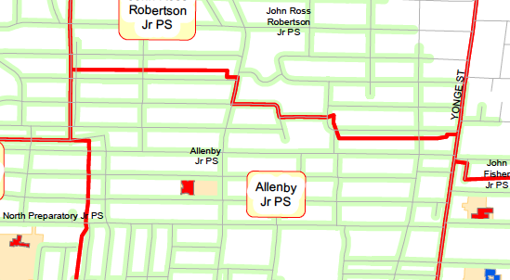
Options: Boundary Change Current English Catchment
Lytton
Hillhurst
Avenue Road
Castlewood
Roselawn
Eglinton Avenue

Slide 17
Options: Boundary Change N/E
To John Ross Robertson
Hillhurst to Lytton/Proudfoot to Rosewell-54
Eglinton to Briar Hill/Avenue to Yonge- 61*
Roselawn to Briar Hill/Rosewell to Yonge -32
* Students in the s/e corner may be over the 1.6 km to JRR

Slide 18
Options: Boundary Change West
To North Prep
Latimer to Heddington/Eglinton to Roselawn- 53
Castlewood/ Eglinton to Roselawn- 20
Heddington/ Eglinton to Roselawn – 8
Latimer/ Eglinton to Roselawn – 20
Latimer to Castlewood/Eglinton to Roselawn-42
None of these total 100 students needed so more research needed and possibly a wider change.

Slide 19
Boundary Changes: Positive Considerations
Decreasing overall number of students will immediately decrease strain on Allenby’s common facilities including:
“Green” space - playground
Cafeteria
Gym
Pool
Bathrooms
Hallways/Stairways
Decrease traffic congestion at drop off/pick up
Possibly contribute to smaller classrooms and more room for children to work in small groups
Allow continuation of enrichment/music room/daycare and other programming with fewer a la carte programs than might occur with no boundary change

Slide 20
Boundary Changes: Negative Considerations
Huge social impact on moving children to new school.
Junior high/high school pathway could be impacted
Would likely cover large area to achieve intended reduction of population.
“Community Uproar” if new school is not considered equal caliber.
Since neighbouring schools are unlikely able to absorb additional students, such schools may require a build, thereby making a build at Allenby very unlikely

Slide 21
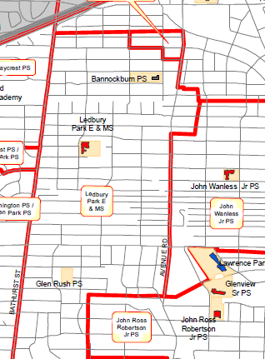
Bannockburn - Allenby North
OPTION 1- move JK/SK children from both streams
OPTION 2- move grades 5-6 children from both streams
Location: Just south of Wilson between Avenue and Bathurst

Slide 22
Bannockburn – Positive Considerations
No boundary changes (grade stays together JK-Grade 6 and same pathway).
Relief for facilities with potential for space for rotary subjects at both sites.
Less pressure on field.
No construction upheaval.
For JK/SK a dedicated early learning environment.

Slide 23
Bannockburn – Negative Considerations
Bussing kids (different implications for both age groups).
Could split families.
No pool at Bannockburn (more of an issue for older kids).
Fundraising and parent volunteering complications.
Extracurricular complications for older grades.
Before and aftercare for JK/SK moves to Bannockburn.
Multiple transitions for children
Negative health impact in losing walk to school

Slide 24
RANKING OF OPTIONS
A BUILD, REPURPOSE SPACE & CLOSE FI - 1 to 5 (with 5 strongly disagree, 4 disagree, 3 neutral, 2 agree and 1 strongly agree)
B BOUNDARY CHANGES TO THE WEST THAT WOULD FEED NORTH PREP
C BOUNDARY CHANGES TO THE NORTH/EAST THAT WOULD FEED JOHN ROSS ROBERTSON
D BANNOCKBURN EARLY YEARS ACADEMY (JK/SK)
E BANNOCKBURN GRADE 5 AND 6
F Repurpose School Space (including Daycare)

Slide 27
Back-up

Slide 28
Pick-up and Drop-off
Increased strain will occur on ALL space and may impact on students feeling of well being during the day
Building will not address strain on all other components of school life
The increased traffic in and around the school will lead to unsafe congestion of cars, further the need for several more parent volunteers, additional signage and community/resident support to make school pick up and drop off children safe. As it stands now pick up drop off poses safety concerns
Issues regarding where children gather, line up and enter must be resolved
The current KG playground is not large enough to hold the number of incoming students in the morning and teachers must work out a play schedule
Adding KG children to the large yard? Where? The current large play scape cannot be utilized by KG children during school hours-it is too high
The teachers would need to work out a schedule for all classes to play in the small yard during alternate times of the day

Slide 29
Boundary Changes w/o Grandfathering: Pros
Immediately decrease strain on Allenby’s common facilities including:
“Green” space
Cafeteria
Gym
Pool
Bathrooms
Hallways/Stairways

Slide 30
What we need to consider: Boundary Changes w/ grandfathering
Strengths:
Minimal social impact on existing children. Inexpensive/cost effective
Decrease overall number of students
Decrease pressure on facilities
Decrease pressure on green space
Decrease in traffic problems at drop off and pick up
Alleviate safety concerns caused by overcrowding
Will allow continuation of enrichment/music room/daycare and other programming with fewer a la carte programs (in the mid term as grandfathered students graduate)
Potentially shorter commute for some students to new school
Longer-term solution for a school that was already overcapacity before FDK (will also address general overcrowding)
Minimize impact of real estate developments at Yonge and Eglinton.
Can be implemented quickly

Slide 31
What we need to consider: Boundary Changes w/ grandfathering
Weaknesses:
May not be a stand-alone solution (at least in the short-term)
May have minimal impact / boundary adjustment might have to be big to free desired space.
Potentially longer commute for some kids.
Social impact on children.
Property values.
English/French inequality if boundaries adjusted unequally.
“Community uproar”

Slide 32
Boundary Changes w/o Grandfathering: Pros
Decrease traffic issues at drop off and pick up
Allow continuation of enrichment programs and full size music room
Allow additional programming
Avoids the need to repurpose space occupied by Allenby Daycare
Minimize or eliminate a-la-carte programs

Slide 33
Boundary Changes w/o Grandfathering: Cons
Huge social impact on moving children to new school
Would likely cover large area to achieve intended reduction of population
“Community Uproar” if new school is not considered equal caliber
Since neighboring schools are unlikely able to absorb additional students, such schools may require a build, thereby making a build at Allenby very unlikely

Slide 34
Boundary Changes w/Grandfathering: Pros
Minimal social impact on existing children
Inexpensive/cost effective
In longer-term will decrease:
Overcrowding
Pressure on facilities and common areas (i.e. gym, pool, cafeteria)
Pressure on green space
Traffic problems at drop off and pick up
Impact of safety concerns caused by overcrowding

Slide 35
Boundary Changes w/Grandfathering: Pros
Will allow continuation of enrichment/music room/daycare and other programming with fewer a la carte programs (in the mid term as grandfathered students graduate)
Potentially shorter commute for some students to new school
Minimize impact of real estate developments at Yonge and Eglinton
Can be implemented quickly
Notes:
35

Slide 36
Boundary Changes w/Grandfathering: Cons
May not be a stand-alone solution (at least in the short-term)
May have minimal impact - boundary adjustment might have to be big to free desired space
Potentially longer commute for some kids –
Property values
English/French inequality if boundaries adjusted only for one
“Community uproar”

Slide 37
Benefit of Music Program
It is well documented that children’s intellectual and emotional development is enhanced through study of the arts . Students develop the ability to think creatively and critically (Ontario Curriculum, 2009)
Promotes artistic literacy
Promotes risk taking, self awareness, self-confidence
Promotes creative problem solving
Encourages innovative thinking, spontaneity, intuition, divergent thinking, and improvisation (Ontario Curriculum, 2009)
Music contributes to the development of listening and cognitive skills
Affects auditory verbal memory

Slide 38

Overall Workable Options: Decision Tree??
Boundary changes
No Boundary Changes
Don’t Build FDK Classrooms
No Grandfathering
Grandfathering
Build FDK Classrooms
Use 2 Daycare Rooms for FDK
Use 102 and 1 Daycare Room for FDK
Portables Temporarily
Use 006 as Classroom
Use 1 Daycare Room as Classroom or as Staff Room or HSP Rooms (and replace with classroom)
Use Part of Music Room
Use Part of Music Room

Slide 39
Basic Decision to Obtain 2 Classrooms for FDK
BUILD
OR
BOUNDARY CHANGES

Slide 40
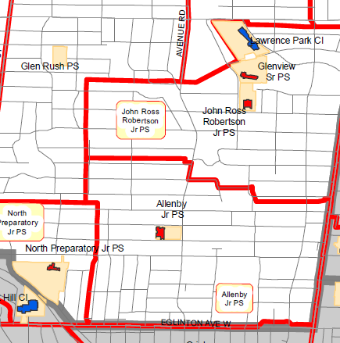
Program Change: 1-6 school
Would be done through a boundary change so that students who would be within Allenby’s boundaries for SK-6 would go to another school for JK – likely to both North Prep and JRR

Slide 41
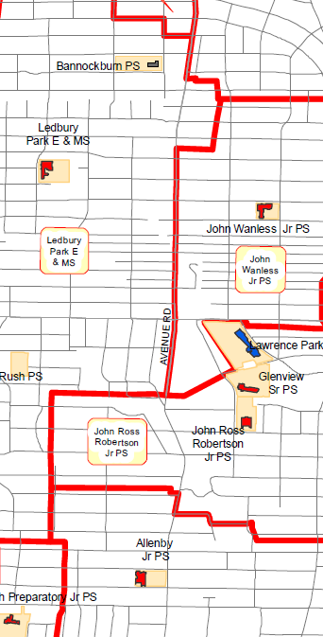
Program Change: Allenby 1-6 School
Allenby becomes a
SK-6 school
Assumptions:
Unlikely to be a FDK school created at Bannockburn PS, which is currently leased out
Is costly to retrofit and bus students. Other schools don’t want it.
Note: Bannockburn PS not suitable for middle school site.

Slide 42
FDK/Space Committee
Committee formed after the first FDK meeting Dec 15, 2011
Committee represents a cross-section of Allenby population:
English, French, Daycare parents, parents of younger and older children, and all of the borders (North, South, East and West)
Committee reviews data and submits requests for additional data from the TDSB
Meeting in December brainstormed several potential scenarios and developed pros and cons
Meeting February 20th looked at more potential scenarios and developed questions to request more data from the TDSB

Slide 43
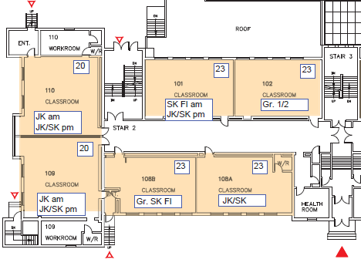
Current Footprint: We have 5 and need 7 rooms to incorporate FDK
Exit to JK/ SK Playground
891 sq. ft
Main Door of School
756 sq. ft
720 sq. ft

Slide 44
Repurpose Daycare Rooms: What does this mean for current programs?
Since there will no longer be ½ day kindergarten once FDK is implemented at Allenby in 2014-2015, there will no longer be a need for Kindergarten child care during school hours.
006 and Room # 2 are also used after the school day for before and after care programs.
There are currently 102 children enrolled in such programs and a waitlist of 393 children.
Repurposing this space relates to use of these rooms during the school day for classrooms.

