Slide 1
Allenby Jr. Public School
FDK/Space Committee Presentation to the
Allenby Parent Association
March 27, 2013

Slide 2
WHY ARE WE HERE?
FDK will start at Allenby in September, 2014. We cannot opt out of or delay FDK.
We need to find space to accommodate FDK and increasing enrollment:
Allenby is projected to have approximately 100 additional full time students (FTE) in the school:
In 2012, there are 690 FTE
In 2014, there will be 797 FTE

Slide 3
Allenby Projected Student Population Growth
 | Actual Oct. 2012 | Projected Oct. 2014 | Projected Oct. 2022
Enrolment (FTE) | 393 (English) 297 (French) 690 | 483 (English) 314 (French) 797 | 491 (English) 298 (French) 789
Existing Ministry Rated Capacity | 654 | 654 | 654
Utilization Rate | 105% | 122% | 121%
TDSB Projected Additional FDK Rooms Needed Compared with 2012-2013 | n/a | 2 | 2
TDSB Projected Additional Regular Classrooms Needed Compared with 2012-2013 | n/a | 2 | 2

Slide 4
What do we need to accommodate this growth?
TDSB estimates we need:
2 regular size classrooms to accommodate forecasted growth
AND
2 FDK size classrooms (over 800 sq. ft) with bathrooms

Slide 5
Purpose of Tonight’s Meeting
To develop preferred potential workable solutions for the Allenby PART Representatives to present at the April 2nd PART meeting:
Review all possible scenarios to accommodate FDK and forecasted Allenby student growth.
“Vote” on preferred options once all scenarios have been reviewed.

Slide 6
Timeline and Summary of Upcoming Meetings
PART meeting - April 2nd: Potential workable solutions presented from each school by their PART representatives. Impact of those potential workable solutions on the other Ward 8 schools to be discussed. The results of the discussion at this meeting will be shared at the Public Meeting on April 16th.
Public Meeting #2 – April 16th: This will be a working meeting where each school will meet in a separate room to discuss possible options, workable solutions and impacts of the implementation of FDK in their school. If you cannot attend, a written submission can be sent in so that your voice is heard. This is the meeting where we will be trying to finalize Allenby’s position.
PART meeting - April 30th: Final recommendations discussed by the PART. To be written up and discussed at the final Public Meeting May 15th.
Final Public Meeting #3 - May 15th: The PART committee will present its findings, in preparation for the report that will go to the Board of Trustees. There will be time for questions and comments from the audience.

Slide 7
What Has Been Done To Date?
FDK/Space Committee has been continuously reviewing data and submitting requests for additional information from the TDSB.
Brainstormed several potential scenarios and developed pros and cons as data received.
Held an in-depth FDK discussion at the APA meeting in February.
Allenby PART members met with the TDSB Planning Department and Superintendant on February 26th and March 8th for ½ day meetings at Allenby to review space and potential options for accommodating FDK. This included a walk through Allenby to inspect the space.
The results of those meetings, additional FDK/Space Committee meetings and small group research on specific issues has culminated in the development of potential scenarios for review this evening.

Slide 8
What We Know
Allenby will remain a dual track school (French and English)
TDSB is willing to close optional attendance for French Immersion
TDSB is looking into the exemption possibilities for primary French Immersion classes
TDSB prefers to find space within schools
The Ministry and by definition the TDSB prefers to maintain daycares within schools with revised viable business models if space permits
There is funding available ONLY for FDK spending
Capital plans are under consideration to sell off TDSB properties

Slide 9
What Solutions Are Off The Table?
Repurposing of the pool:
Cost associated to fill pool - min $800K
Needed to meet gym requirement
“Save our Pool” Campaign
JK/SK Boundary change or specialized “academy”:
Bussing young kids and the costs associated with new school does not fit with capital plan
No room at nearby schools for all of the JK/SKs to move given space requirements for FDK classroom sizes

Slide 10
What Are The Options To Find 4 Classrooms?
Boundary Change: Redraw the existing catchment
Build: Expand the existing Allenby footprint by building 2 classrooms for FDK
Repurpose: Find space in the existing Allenby footprint
NONE OF THESE OPTIONS ARE MUTUALLY EXCLUSIVE
NOTE: It is unlikely that TDSB will consider program change (e.g. Allenby continuing as a Gr 1- 6 school relocating kindergarten)

Slide 11
Options: Boundary Change
As part of considering all options, TDSB staff have started to model potential boundary changes.
IMPORTANT: Exact boundaries that could be affected, if a boundary change was approved by the TDSB, have not been determined.
However, the TDSB has indicated the following re: viability of certain boundary changes

Slide 12
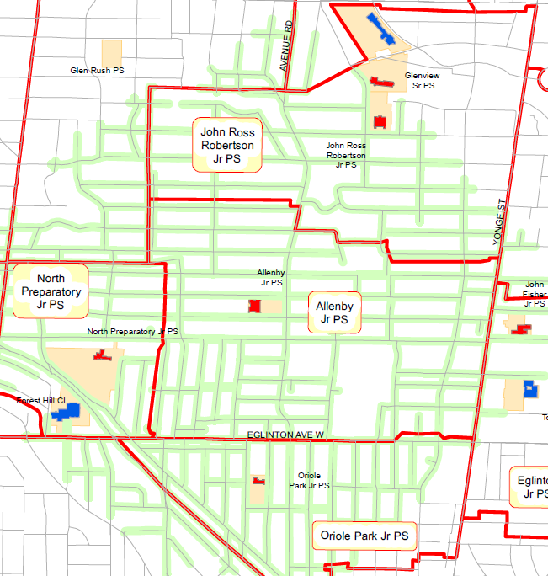
Options: Boundary Change
Change at the S/E boundary is not viable
Eglinton Jr. P.S. is overcapacity, does not have any room to build
would involve students crossing Yonge St.
Change requiring students to cross Eglinton Ave to go to Oriole Park Jr. P.S. (overcrowded) is not viable
Change at the N/W border is not viable as nearest schools are all beyond max. 1.6 kms walking distance

Slide 13
Options: Boundary Change
Western border still a potential option to be explored
- depends on space at North Prep Jr. P.S.
N/E border still a potential option to be explored
- depends on space at JRR

Slide 14
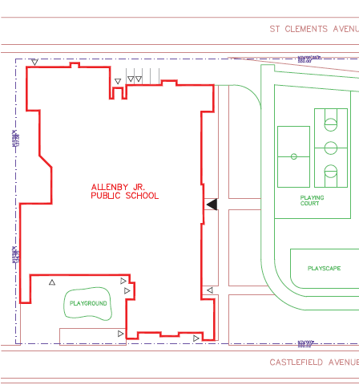
Options: Build: 2 classrooms on Castlefield
Approximate location of addition. Not to scale. To be built into hill.

Slide 15
Options: Build: 2 classrooms on Castlefield
2 classrooms on the hill area with the use of a bridge or tunnel to connect to the school.
Planning has hired an architect to determine cost and building specs (could have a footprint to support an additional 2 classrooms in the future).
Will know feasibility by April 16th meeting (Process takes about 3 weeks)

Slide 16
Options: Build: 2 Classrooms on Castlefield
- Assumption: TDSB will not recommend building on more than one school involved in the PART.
- Allenby may be the only school involved in this PART that needs to build to accommodate FDK.
- Funds are likely available.

Slide 17
Options: Re-Purpose Space
What spaces in the school (not currently used as classrooms) can be potentially repurposed as classrooms?
Music Room
Rooms currently used by Daycare

Slide 18
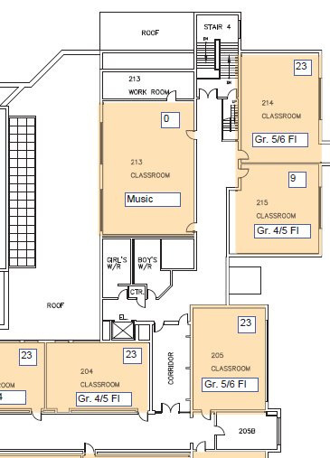
Repurpose Music Room- Where is it?
1596 sq. ft

Slide 19
Repurpose Music Room: How can it be repurposed?
Divide Music room into 2 rooms (1 classroom, 1 small music room)
Divide Music room into 2 rooms (2 classrooms, 0 music room)
Neither option above will accommodate a Kindergarten classroom in this space

Slide 20
Repurpose Music Room: How is it currently used?
Whole room is currently used (Orff Approach to teaching music. A hands-on approach with instruments)
Dance/Drama also uses space during the day
Only space large enough for 2 classes to prepare for performances (designed as multi-purpose space for larger groups)
Used for Primary/Junior Choir, folk dancing, Peer helper training, grade 6 graduation, after 4
Storage is used for band/string instruments

Slide 21
Repurpose: Rooms Currently Used by Daycare
Allenby Daycare currently leases 3 rooms in Allenby:
Room 006
Room #1
Room # 2
The Daycare’s current lease expires August 31, 2015. Checking with TDSB legal to better understand lease changes

Slide 22
Repurpose: Rooms Currently Used by Daycare
TDSB staff have indicated that the TDSB’s general position regarding daycares within TDSB schools is: - leases will be honoured, and - it is beneficial to child development for a child to stay in same educational environment from 18 months- grade 6

Slide 23
Repurpose: Rooms Currently Used by Daycare
There are currently 102 children enrolled in the daycare program and a waitlist of 393 children.
All children in the daycare are in district Allenby school children and most nursery children are siblings of Allenby school children
Daycare assisted the funding of Rooms 1 and 2 and received a grant to help fund the kindergarten playground

Slide 24
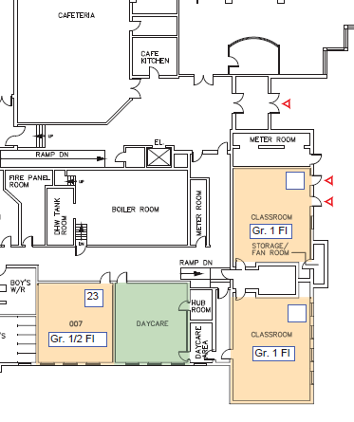
006- Where is it?
680 sq ft

Slide 25
006: How is it currently used?
Located beside room 007 on the lower floor
Not currently used during the day
Currently used by Allenby daycare for before and after school care
May be utilized as a grade one classroom- Insufficient square footage for an alternate grade (only 680 sq. ft)

Slide 26
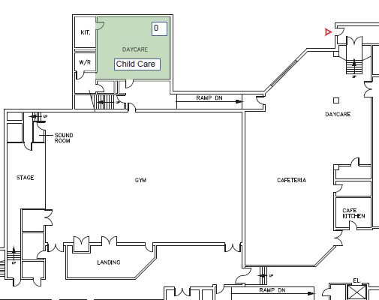
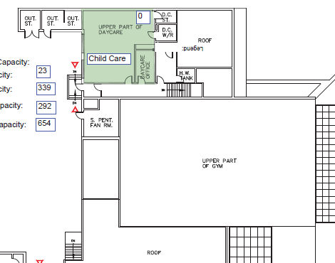
Rooms 1 and 2: Where are they?
1293
Sq. ft.
1047
Sq. ft.

Slide 27
Rooms 1 and 2: How are they currently used?
Room #1 with 1047 sq. ft is currently used for a nursery school program (am and pm) AND for before and after care for school age children
Room #2 with 1293 sq. ft is currently occupied during the day for kindergarten students not in school AND for before and after care for school aged children during the day.

Slide 28
Repurpose Daycare Rooms: What does this mean for current programs?
Since there will no longer be ½ day kindergarten once FDK is implemented at Allenby in 2014-2015, there will no longer be a need for Kindergarten child care during school hours.
The daycare may need to replace this program with a larger “Early Years Program” in order to maintain a viable business.
006 and Room # 2 are also used after the school day for before and after care programs.
Repurposing this space relates to use of these rooms during the school day for classrooms.

Slide 29
Considerations
BUILD & REPURPOSE SPACE
BOUNDARY CHANGES & REPURPOSE SPACE
REPURPOSE SPACE
BOUNDARY CHANGES

Slide 30
Boundary Changes: Considerations
Early indication is that the TDSB prefers to grandfather existing students impacted by boundary changes where space is available.
Allenby’s population currently exceeds capacity which leads directly to lack of space. Therefore the viability of grandfathering must be closely examined

Slide 31
Boundary Changes: Positive Considerations
Decreasing overall number of students will immediately decrease strain on Allenby’s common facilities including:
“Green” space - playground
Cafeteria
Gym
Pool
Bathrooms
Hallways/Stairways
Decrease traffic congestion at drop off/pick up
Possibly contribute to smaller classrooms and more room for children to work in small groups
Allow continuation of enrichment/music room/daycare and other programming with fewer a la carte programs than might occur with no boundary change

Slide 32
Boundary Changes: Negative Considerations
Huge social impact on moving children to new school.
Junior high/high school pathway could be impacted
Would likely cover large area to achieve intended reduction of population.
“Community Uproar” if new school is not considered equal caliber.
Since neighbouring schools are unlikely able to absorb additional students, such schools may require a build, thereby making a build at Allenby very unlikely

Slide 33
Building On Site: Positive Considerations
The combination of (1) building 2 classrooms on site and (2) repurposing space to find 2 additional classrooms could remove the need for boundary changes.
The above combination could provide Allenby with flexibility to find more space within the school (if needed) as compared to the option of repurposing only, which will leave Allenby with no room to grow.
Building FDK classrooms could include building new bathrooms for those classrooms.

Slide 34
Building On Site: Negative Considerations
Increased strain will occur on ALL space (facilities/green space) and may impact on students feeling of well being during the day
Building will not address strain on all other components of school life
Increased traffic in and around the school will lead to unsafe congestion of cars, further the need for several more parent volunteers and other actions to improve traffic safety. As it stands now pick up drop off poses safety concerns. Parents would need to fundamentally change their approach to Pick-up and Drop-off
Issues regarding where children gather, line up and enter must be resolved
The current KG playground is not large enough to hold the number of incoming students in the morning and teachers must work out a play schedule
The teachers would need to work out a schedule for all classes to play in the small yard during alternate times of the day

Slide 35
Repurposing Rooms as a Stand Alone Option
While Allenby MAY be able to find space for 4 classrooms if all potentially available options were repurposed (1/2 music room, 006, Room #1 and Room #2), Allenby would be left with no options to address any increased growth (Or any underestimation of future attendance at the school).
Would impact music program
Would eliminate Daycare’s preschool program. Would mean losing staff that has been with the daycare for years. Could affect the viability of the Daycare providing before and after school care, necessitating search for other before and after school care provider.

Slide 36
Repurposing Music Room: Positive Considerations
If part or all of the music room were repurposed in combination with a build (and the repurposing of another room), boundary changes may not be required.
If part or all of the music room were repurposed in combination with a build (and the repurposing of 006), Room #1 and Room #2 may not require repurposing.

Slide 37
Repurposing Music Room(2 classrooms): Negative Considerations –
Music program would be taught a la carte, program would NOT exist as it does today, curriculum would be compromised
Orff instruments would not be able to be used (value $15K).
Using instruments is fundamental concept for Gr 1-6 in Ontario Curriculum for arts
Program would be pencil/paper theory; not applying concepts using instruments
Teachers would loose their class for prep if program delivered a la carte (this is already a problem)
Implications for programming other than music (i.e.. dance and drama, choir, folk dancing)

Slide 38
Repurposing Music Room (1/2 music): Negative Considerations
No space for activities for larger groups (peer helpers, grade 6 grad prep, performance rehearsals)
An additional classroom in that space has implications for over-crowded hallways
Implications for programming other than music (i.e. No room to run dance and drama if instruments set-up in smaller space)
Value of music program to education
Encourages innovative thinking, spontaneity, intuition, divergent thinking, critical thinking and improvisation (Ontario Curriculum, 2009)
Music contributes to the development of listening and cognitive skills and affects auditory verbal memory.
High correlation between math test scores and music education

Slide 39
Repurposing 006: Consideration
As space is under lease to Daycare, would require agreement of Daycare to be used as Shared Space before 2015-2016.

Slide 40
Repurposing 006: Positive Considerations
Not currently in use during the day.
Size is appropriate for a regular classroom.
There is a need to use this room as a classroom based on the projected enrollment at Allenby in September 2013.
Can still be shared space to facilitate before-after care programs.
If this room were repurposed in combination with a build and one more repurposed room, boundary changes may not be required.

Slide 41
Repurposing Room #1 or #2: Considerations
Daycare is currently working on a business plan for when FDK arrives. Specifically, the TDSB has asked Daycare to come up with two models:
1. For the operation of a daycare using 1 room during the day; and
2. For the operation of a daycare using 2 rooms during the day.
In addition, the plan will look at before and after care options

Slide 42
Repurposing Room #1 or #2: Positive Considerations
Rooms #1 and #2 are “ready made” FDK rooms; both exceed the minimum size requirements for FDK classrooms and have bathrooms.
Since there will no longer be ½ day kindergarten with FDK, there is no need for Kindergarten child care during school hours.
Can still be shared space for before-after care programs.
If one or both of these rooms were repurposed in combination with a build, boundary changes may not be required.
If one or both of these rooms were repurposed in combination with a build, and 006, the music room may not require repurposing.

Slide 43
Repurposing Room #1 or #2: Negative Considerations
If daycare requires both rooms during the day and will not be able to continue if Room #1 or #2 are repurposed:
There will be a loss of the daycare staff with implications to the program and the 73 families using daycare’s services
Loss of current staff that supervises children both at recess and at lunch time
Allenby could continue to be without a childcare program for pre-school children
Likely loss of summer program for community
Loss of financial contribution from Daycare to Allenby Jr. Public School
Loss of “other contributions” from Daycare to Allenby Public School

Slide 44
RECAP: Implications of Each Option
Boundaries – Decreased strain on Facilities but enormous impact on community
Build – Provides 2 rooms without boundary changes but strain on Facilities and PU/DO
Re-purposing Space – Helps us to find space but not all of the space needed and has increased strain on facilities now and in the future with no wiggle room for future growth. May impact curriculum (music) and Daycare programs as they are run today.

Slide 45
Questions

Slide 46
Basic Decision to Obtain 4 Classrooms for FDK & Increased Enrolment
1.
BUILD & REPURPOSE SPACE
2. BOUNDARY CHANGES & REPURPOSE SPACE
4.
REPURPOSE SPACE
3. BOUNDARY CHANGES

Slide 47
Re-purposing Space to find 4 Classrooms (No Build/No Boundary Changes)
006
&
ROOM 1& 2 SHARED SPACE
&
½ MUSIC ROOM

Slide 48
Option 1 of 2: Re-purposing Space to Find 2 Classrooms for Increased Enrolment
½ MUSIC ROOM
&
006
Shared space

Slide 49
Option 2 of 2: Re-purposing Space to find 2 Classrooms for Increased Enrolment
006 SHARED SPACE
&
ROOM 1 OR 2 SHARED SPACE

Slide 50
END

Slide 51
Back-up

Slide 52
Pick-up and Drop-off
Increased strain will occur on ALL space and may impact on students feeling of well being during the day
Building will not address strain on all other components of school life
The increased traffic in and around the school will lead to unsafe congestion of cars, further the need for several more parent volunteers, additional signage and community/resident support to make school pick up and drop off children safe. As it stands now pick up drop off poses safety concerns
Issues regarding where children gather, line up and enter must be resolved
The current KG playground is not large enough to hold the number of incoming students in the morning and teachers must work out a play schedule
Adding KG children to the large yard? Where? The current large play scape cannot be utilized by KG children during school hours-it is too high
The teachers would need to work out a schedule for all classes to play in the small yard during alternate times of the day

Slide 53
Boundary Changes w/o Grandfathering: Pros
Immediately decrease strain on Allenby’s common facilities including:
“Green” space
Cafeteria
Gym
Pool
Bathrooms
Hallways/Stairways

Slide 54
What we need to consider: Boundary Changes w/ grandfathering
Strengths:
Minimal social impact on existing children. Inexpensive/cost effective
Decrease overall number of students
Decrease pressure on facilities
Decrease pressure on green space
Decrease in traffic problems at drop off and pick up
Alleviate safety concerns caused by overcrowding
Will allow continuation of enrichment/music room/daycare and other programming with fewer a la carte programs (in the mid term as grandfathered students graduate)
Potentially shorter commute for some students to new school
Longer-term solution for a school that was already overcapacity before FDK (will also address general overcrowding)
Minimize impact of real estate developments at Yonge and Eglinton.
Can be implemented quickly

Slide 55
What we need to consider: Boundary Changes w/ grandfathering
Weaknesses:
May not be a stand-alone solution (at least in the short-term)
May have minimal impact / boundary adjustment might have to be big to free desired space.
Potentially longer commute for some kids.
Social impact on children.
Property values.
English/French inequality if boundaries adjusted unequally.
“Community uproar”

Slide 56
Boundary Changes w/o Grandfathering: Pros
Decrease traffic issues at drop off and pick up
Allow continuation of enrichment programs and full size music room
Allow additional programming
Avoids the need to repurpose space occupied by Allenby Daycare
Minimize or eliminate a-la-carte programs

Slide 57
Boundary Changes w/o Grandfathering: Cons
Huge social impact on moving children to new school
Would likely cover large area to achieve intended reduction of population
“Community Uproar” if new school is not considered equal caliber
Since neighboring schools are unlikely able to absorb additional students, such schools may require a build, thereby making a build at Allenby very unlikely

Slide 58
Boundary Changes w/Grandfathering: Pros
Minimal social impact on existing children
Inexpensive/cost effective
In longer-term will decrease:
Overcrowding
Pressure on facilities and common areas (i.e. gym, pool, cafeteria)
Pressure on green space
Traffic problems at drop off and pick up
Impact of safety concerns caused by overcrowding

Slide 59
Boundary Changes w/Grandfathering: Pros
Will allow continuation of enrichment/music room/daycare and other programming with fewer a la carte programs (in the mid term as grandfathered students graduate)
Potentially shorter commute for some students to new school
Minimize impact of real estate developments at Yonge and Eglinton
Can be implemented quickly
Notes:
59

Slide 60
Boundary Changes w/Grandfathering: Cons
May not be a stand-alone solution (at least in the short-term)
May have minimal impact - boundary adjustment might have to be big to free desired space
Potentially longer commute for some kids –
Property values
English/French inequality if boundaries adjusted only for one
“Community uproar”

Slide 61
Benefit of Music Program
It is well documented that children’s intellectual and emotional development is enhanced through study of the arts . Students develop the ability to think creatively and critically (Ontario Curriculum, 2009)
Promotes artistic literacy
Promotes risk taking, self awareness, self-confidence
Promotes creative problem solving
Encourages innovative thinking, spontaneity, intuition, divergent thinking, and improvisation (Ontario Curriculum, 2009)
Music contributes to the development of listening and cognitive skills
Affects auditory verbal memory

Slide 62

Overall Workable Options: Decision Tree??
Boundary changes
No Boundary Changes
Don’t Build FDK Classrooms
No Grandfathering
Grandfathering
Build FDK Classrooms
Use 2 Daycare Rooms for FDK
Use 102 and 1 Daycare Room for FDK
Portables Temporarily
Use 006 as Classroom
Use 1 Daycare Room as Classroom or as Staff Room or HSP Rooms (and replace with classroom)
Use Part of Music Room
Use Part of Music Room

Slide 63
Basic Decision to Obtain 2 Classrooms for FDK
BUILD
OR
BOUNDARY CHANGES

Slide 64
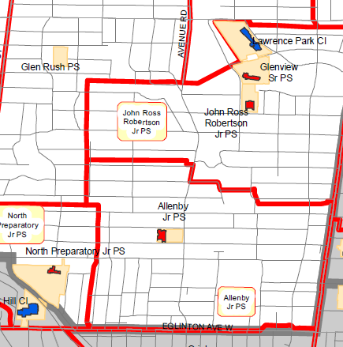
Program Change: 1-6 school
Would be done through a boundary change so that students who would be within Allenby’s boundaries for SK-6 would go to another school for JK – likely to both North Prep and JRR

Slide 65
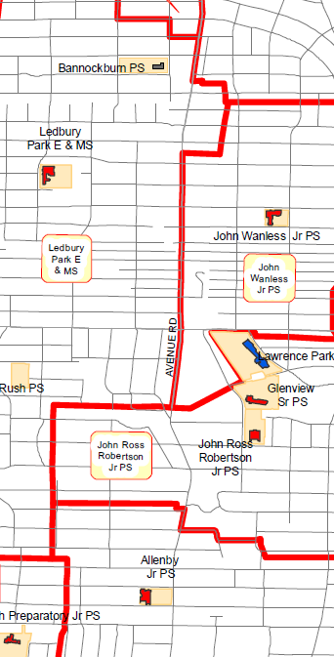
Program Change: Allenby 1-6 School
Allenby becomes a
SK-6 school
Assumptions:
Unlikely to be a FDK school created at Bannockburn PS, which is currently leased out
Is costly to retrofit and bus students. Other schools don’t want it.
Note: Bannockburn PS not suitable for middle school site.

Slide 66
FDK/Space Committee
Committee formed after the first FDK meeting Dec 15, 2011
Committee represents a cross-section of Allenby population:
English, French, Daycare parents, parents of younger and older children, and all of the borders (North, South, East and West)
Committee reviews data and submits requests for additional data from the TDSB
Meeting in December brainstormed several potential scenarios and developed pros and cons
Meeting February 20th looked at more potential scenarios and developed questions to request more data from the TDSB

Slide 67
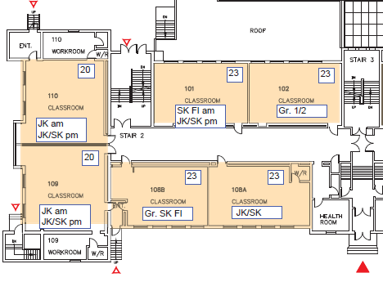
Current Footprint: We have 5 and need 7 rooms to incorporate FDK
Exit to JK/ SK Playground
891 sq. ft
Main Door of School
756 sq. ft
720 sq. ft

Slide 68
Repurpose Daycare Rooms: What does this mean for current programs?
Since there will no longer be ½ day kindergarten once FDK is implemented at Allenby in 2014-2015, there will no longer be a need for Kindergarten child care during school hours.
006 and Room # 2 are also used after the school day for before and after care programs.
There are currently 102 children enrolled in such programs and a waitlist of 393 children.
Repurposing this space relates to use of these rooms during the school day for classrooms.

